Slide 1
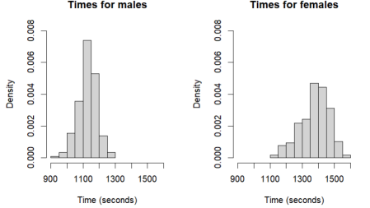

2. Comparison of Male and Female Time
2

Slide 2
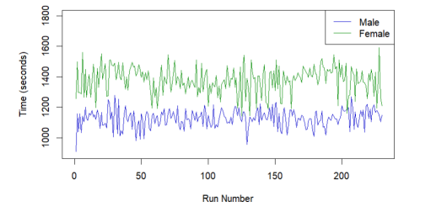
3.Changes over time
3

